Slide 1
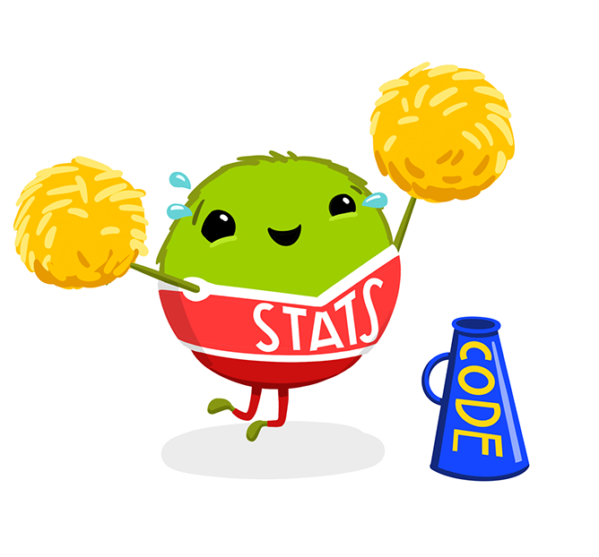
Introduction to R
York Psychology ECR Workshop
6th November 2024

Slide 2
Workshop Objectives
Orient you to working in R and RStudio
Introduce you to some useful tools for data cleaning and processing
Highlight useful features for reproducibility
Materials are online – you can go back to them or finish up later if we don’t make it to the end

Slide 3
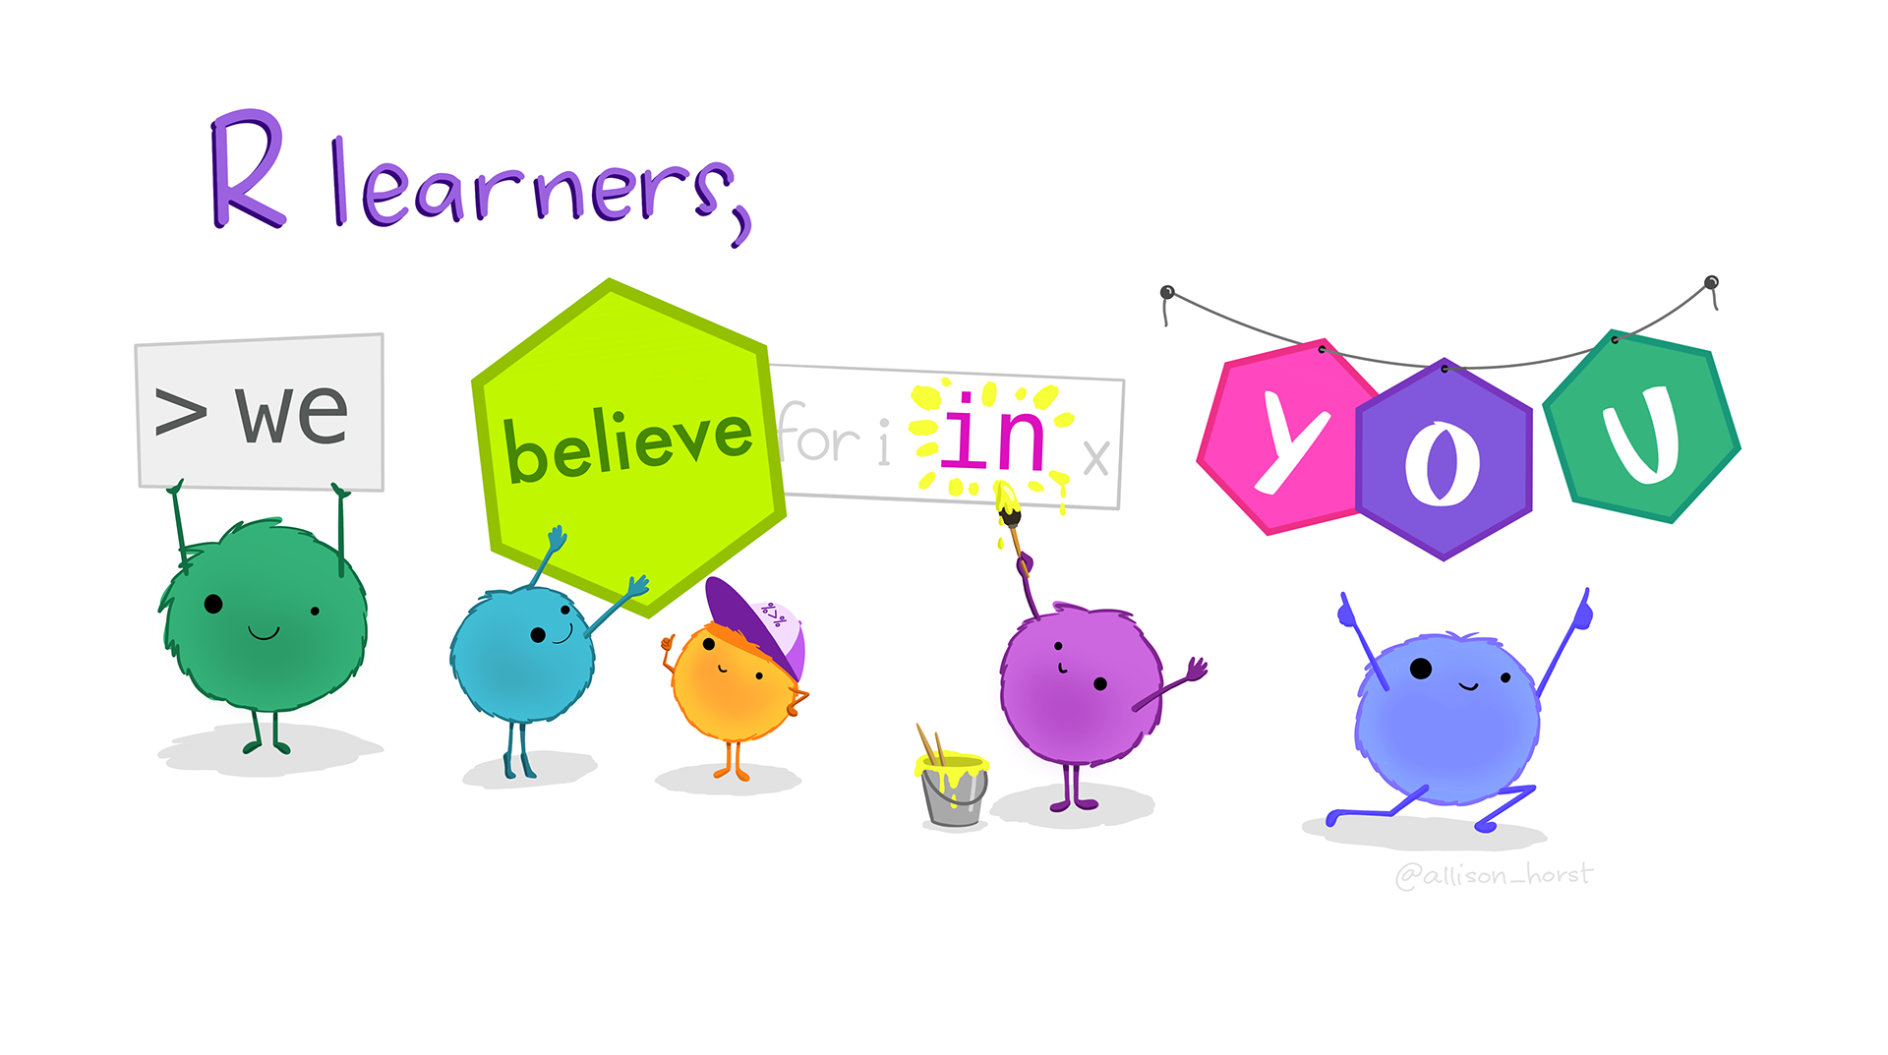
Workshop principles
Ask questions whenever!
Wave at Jamie if something’s gone weird
Sticky notes:
Yellow – hold up/slow down, I’m stuck
Green – I’ve finished the exercise, we’re good to go
Respect that other people might work at different paces
Help each other
Multi-task

Slide 4

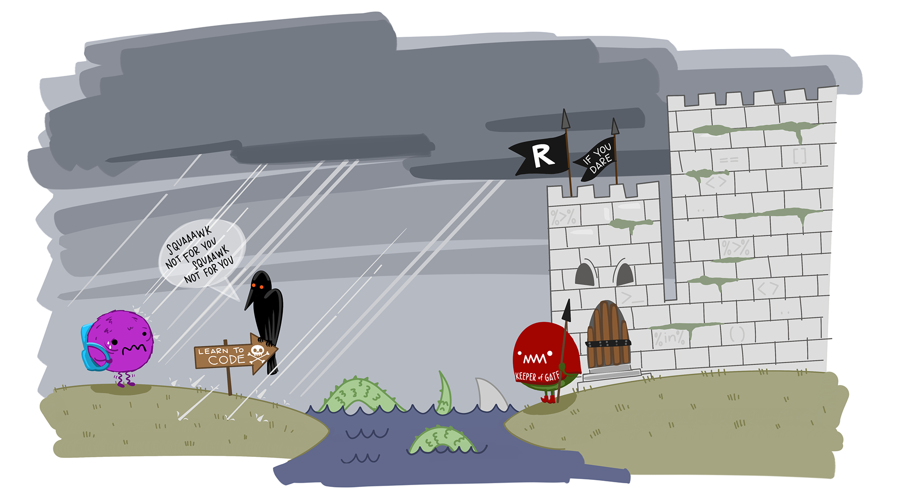

What is R?
www.r-project.org
R is a widely used, free software environment geared towards running statistical tests
It is a programming language, not unlike Matlab and Python
Steeper learning curve than SPSS
Strong online community with lots of free resources

Slide 5
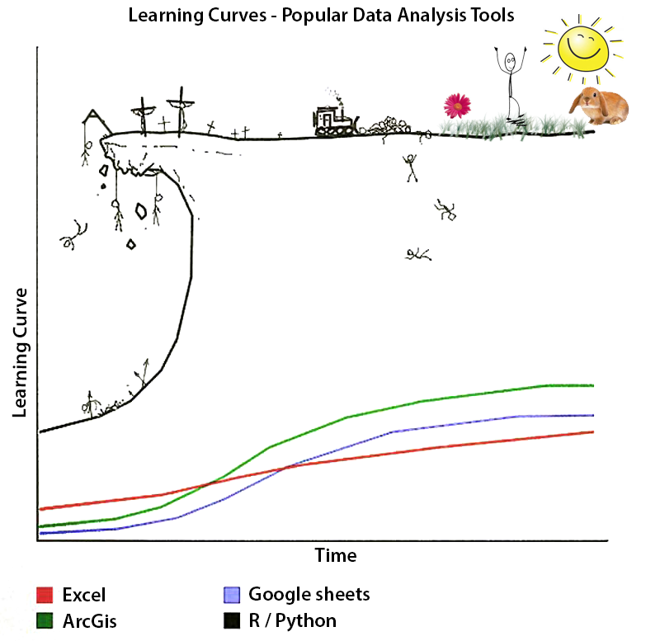
Why use R?
More powerful and flexible
Many advanced statistical tools
Supply and demand with developers
Code anything you want
Reproducible and transparent
Highly efficient
Free and widely supported

Slide 6
Basics of R
Core idea of programming: type out some instructions in a special language, to tell the computer what to do
Differs from pointy-clicky software like SPSS, where you choose options from menus
People write ‘functions’ to do different things, e.g. there is a t-test function called t.test()
… but not restricted to these: you can code things manually, or even program your own functions!

Slide 7

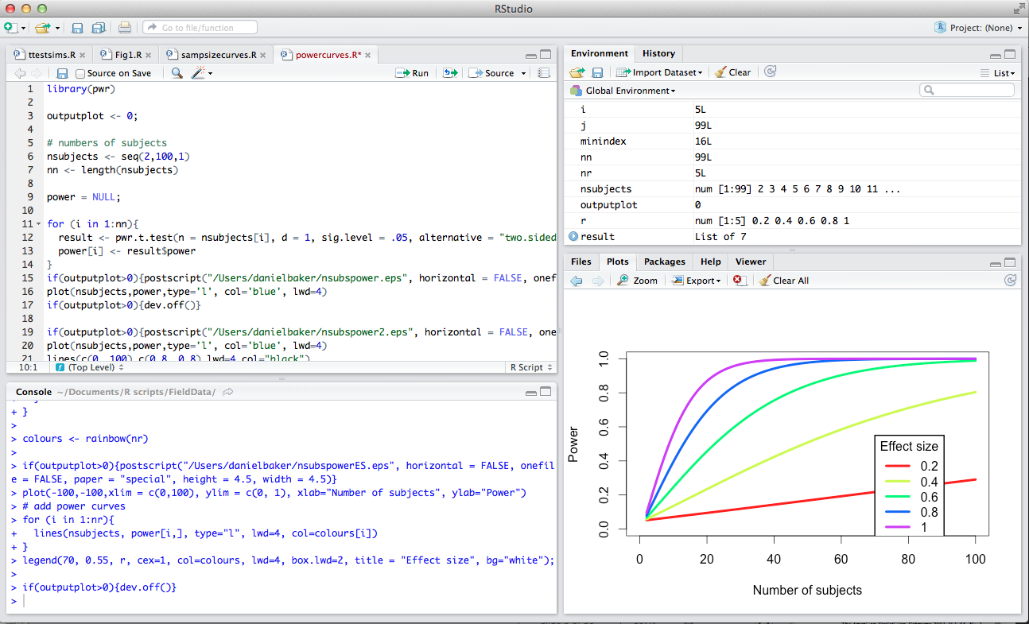
RStudio is a freeware R environment that has several user-friendly features

